Slide 1
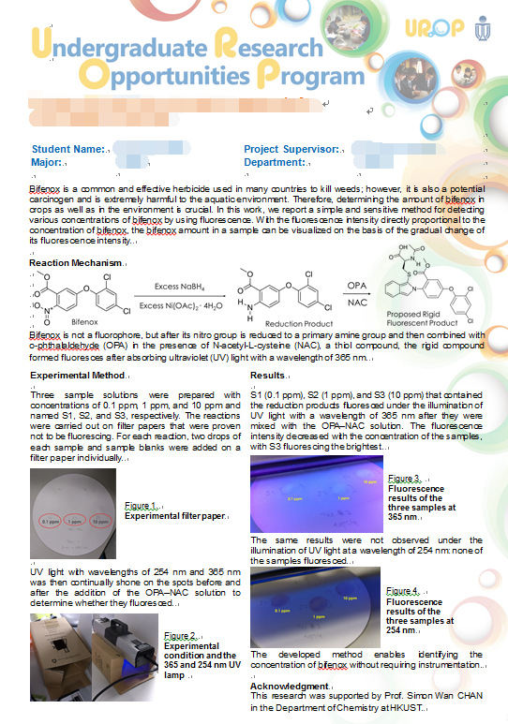
UROP Project Title (example)
Student Name: | CHAN Tai Man (example) | Project Supervisor: | Prof. John WONG (example)
Major / School: | ACCT / SBM (example) | Dept. / School : | ACCT / SBM (example)
Requirements of the Research Poster
Please type contents and/or insert graphics into this poster template and note the following:
Please fill in the project title, student and supervisor information as the examples given above;
Please fit all the contents in ONE slide only;
The contents can be divided into more than one columns if needed;
All graphics used in the poster should be of 300 dpi or above;
The poster will be printed in a size of 980x1300mm, please see the samples below for reference.

